Slide 1

PING-PONG GAME IMPLEMENTATION ON BASYS3 BOARD USING VERILOG HDL
Rajiv Gandhi University Of Knowledge Technologies - Nuzvid
DEPARTMENT OF ELECTRONICS AND COMMUNICATION ENGINEERING
Major Project
Presented by :
U. Manideep (N180605)
P. Jayashankar Reddy (N181004)
B. Chakrarao (N180276)
Guide By :
P Shyam Sir,
- HOD of ECE, RGUKT-Nuzvid.

Slide 2
Content
01. Abstract
02. Introduction
03. About Basys3 board
04. About VGA Monitor
05. Modules
06. VGA controller module & RTL
07. Pixel generation module & RTL
08. Debounce module & RTL
09. Ball Rom module
10. Top module
11. Plan of Action

Slide 3
Abstract
In this project we are implementing Pong Game which is controlled by single player using Push Buttons, and displays the game on a VGA monitor.
It is a table-tennis inspired game featuring simple one, dimensional graphics. In it, the player controls the paddle by moving it vertically across the up or the downside of the screen. A sphere representing a ping pong ball travels across the screen in a linear trajectory. If the ball strikes the perimeter of the playing field, the obstacle in the middle of the room or one of the simulated paddles, the ball ricochets based on the angle of the impact. With every impact on the playing field or obstacle, the ball picks up speed. Speed is reduced upon hitting the paddle.
The aim of this project is to create a Verilog - based application for Pong.
This project mainly focused on the design and implementation of an FPGA-based Ping Pong game, consisting of both the hardware and software design working coherently. For hardware-wise, the host computer was used to program and configure the design; FPGA was implemented for operating the game, and the VGA monitor for display. At the same time, the software part included the design of the overall system, input key module, VGA display module, as well as the game control module. The game design focused on "single Player Mode", which simulates the real-life PING-PONG Game. The movement of the paddles was controlled by pressing the push buttons of FPGA.
Keywords: Verilog , FPGA Basys3 board , VGA Monitor.

Slide 4
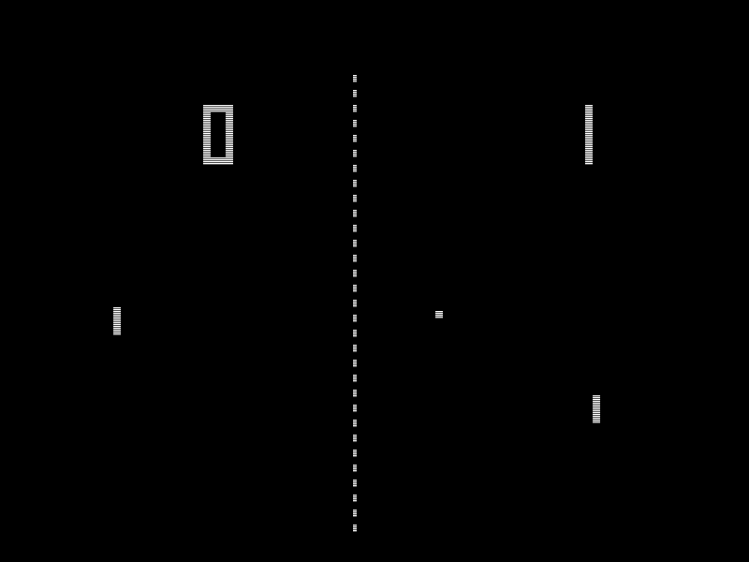
Introduction
The game consists of a display with a sliding paddle that can be controlled by the user, and a fixed wall that acts as the upper bound. When the user presses the start button, which is the up button, the ball will begin bounce up, and will bounce off the wall and attempt to hit the paddle. If the ball hits the paddle, it bounces up again and continues to bounce until it misses the paddle. The game is over when the ball fails to hit the paddle. The user will be able to use the left and right pushbuttons to determine the movement of the paddle. In order to reset the game, the user must push the center button. The time of the run will be recorded on a 7 segment display. There are five levels, and every ten seconds the level increases, until you hit level 5 where it stays till the user loses. The levels are determined by the speed of the ball; this means that every ten seconds, the speed of the ball increases, thus increasing the difficulty of the game.

Slide 5
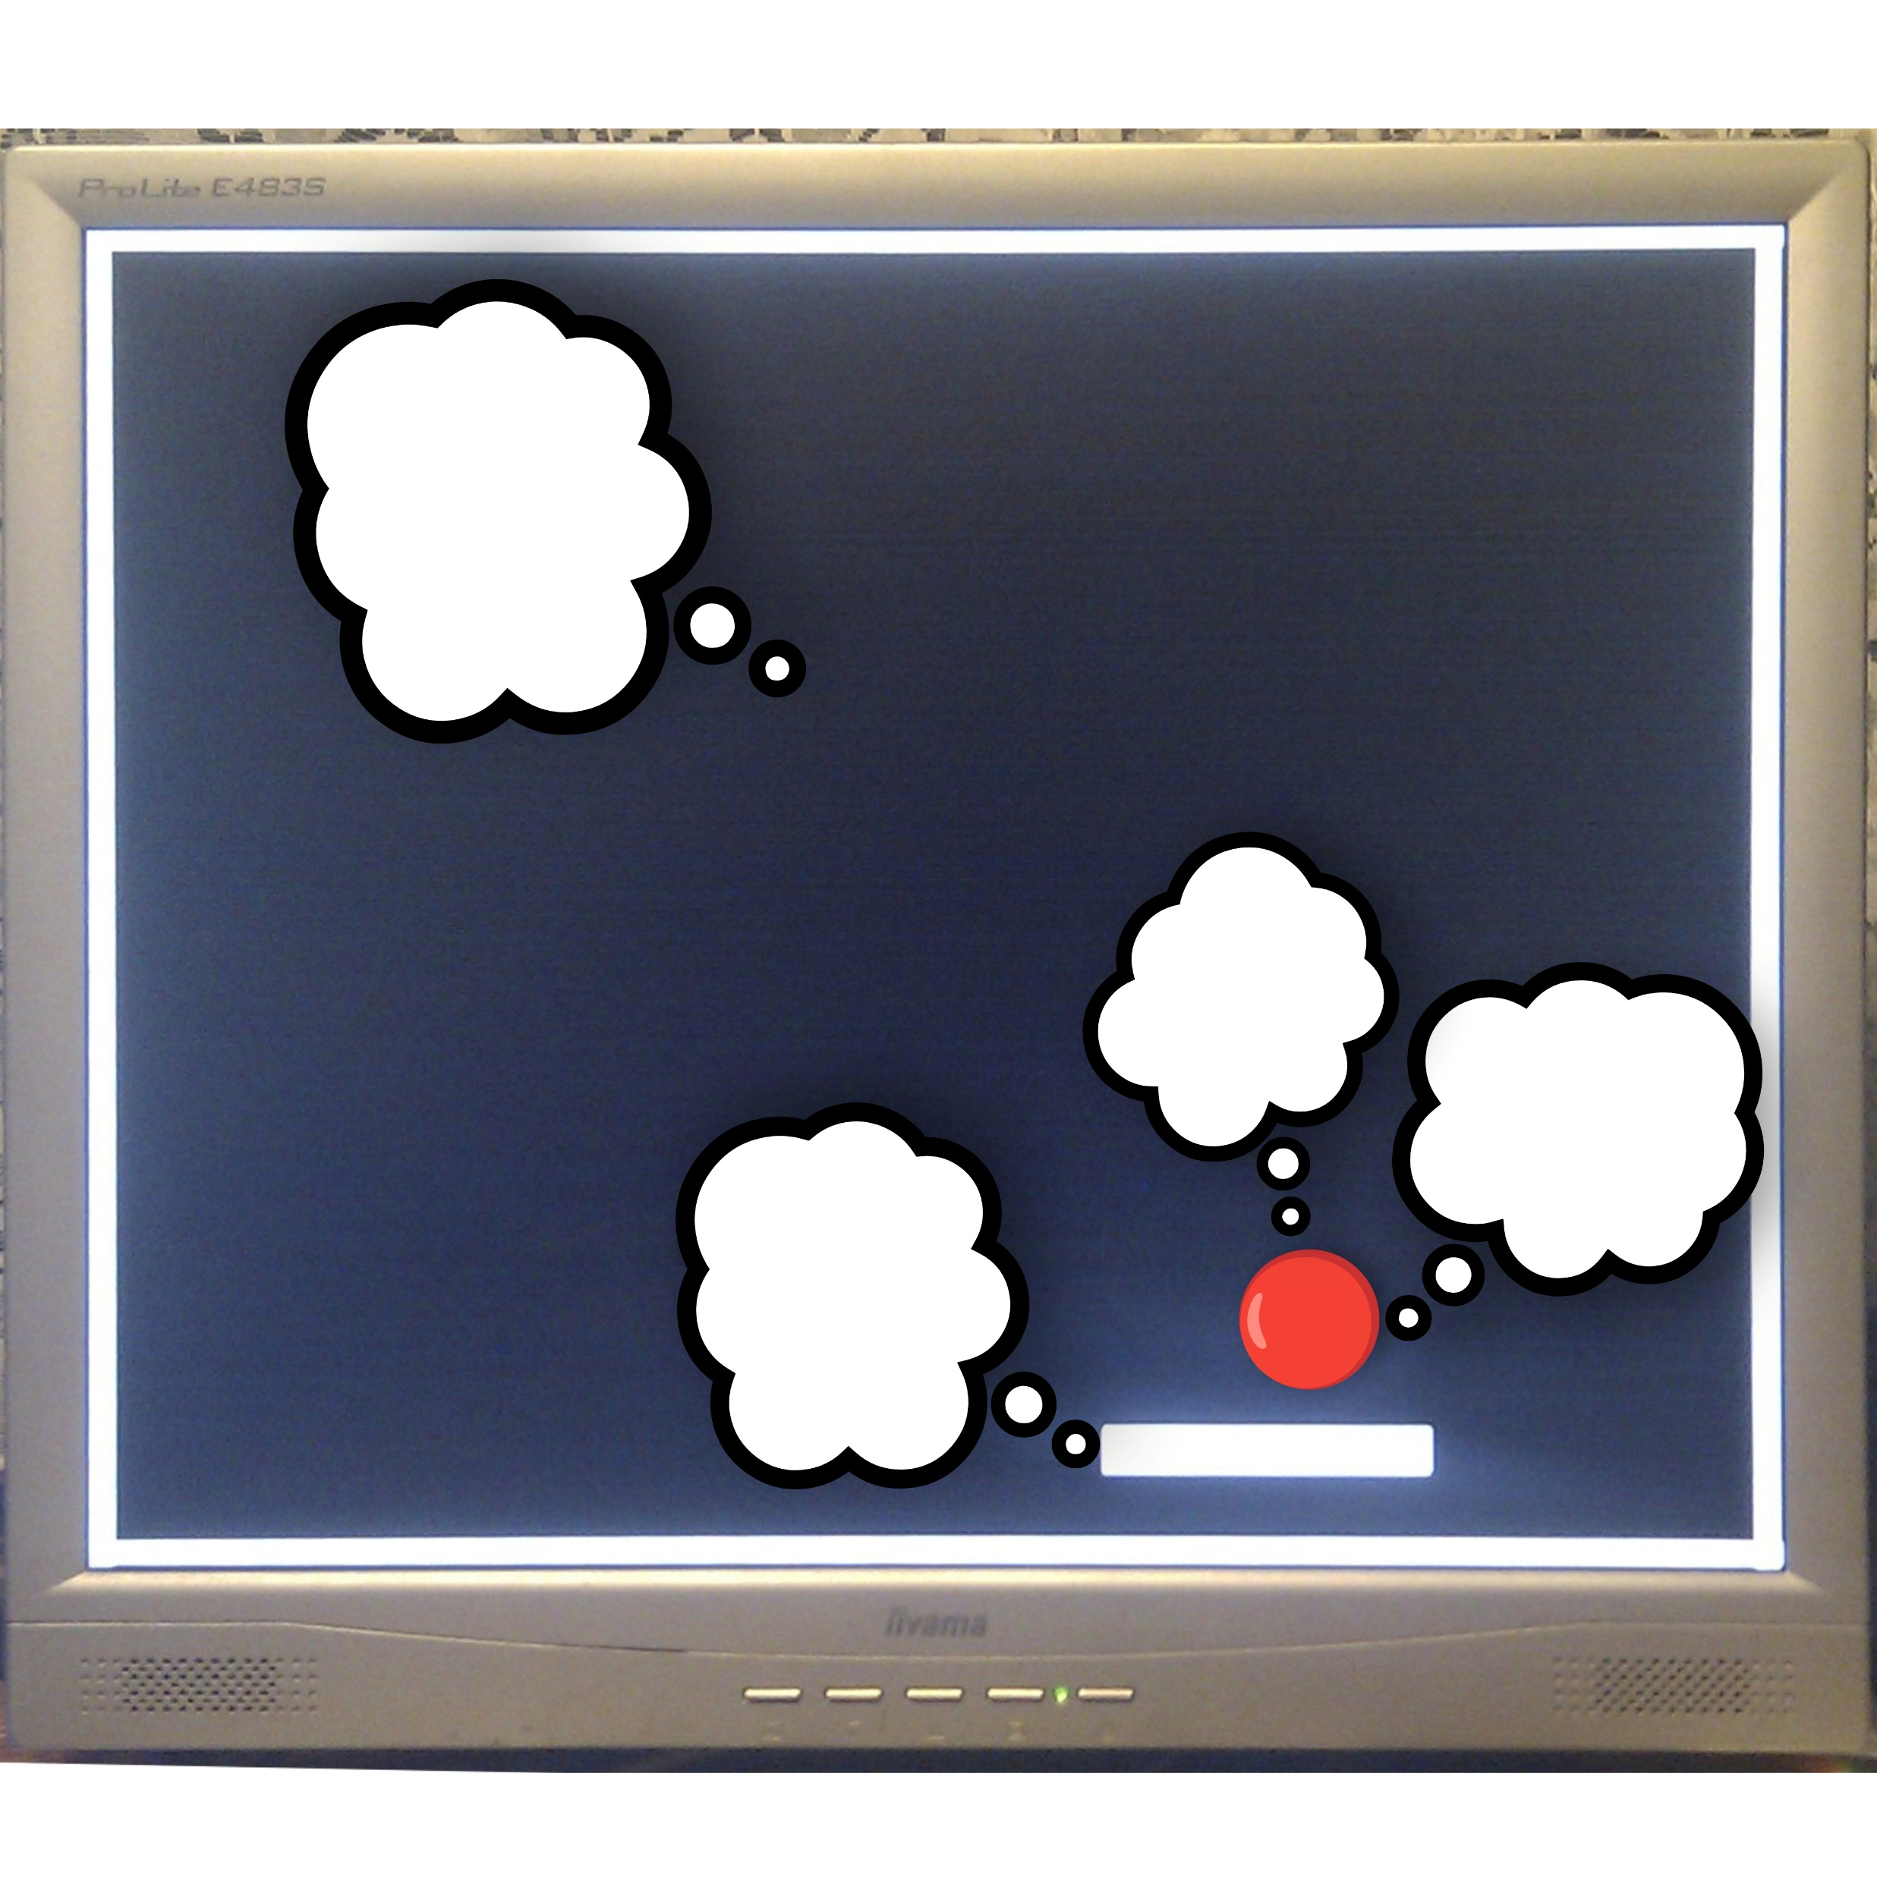

Slide 6
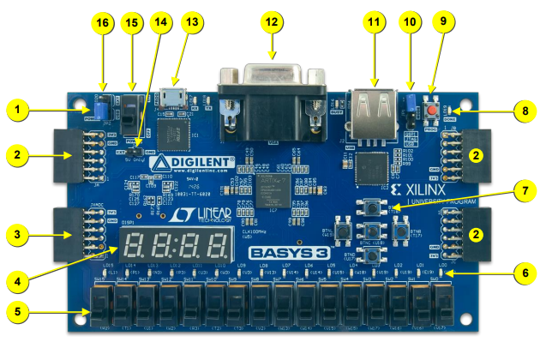
About Basys3 Board
The Basys3 board is a complete, ready-to-use digital circuit development platform based on the latest Artix®-7 Field Programmable Gate Array (FPGA) from Xilinx®. With its high-capacity FPGA (Xilinx part number XC7A35T1CPG236C), low overall cost, and collection of USB, VGA, and other ports, the Basys3 can host designs ranging from introductory combinational circuits to complex sequential circuits like embedded processors and controllers. It includes enough switches, LEDs, and other I/O devices to allow a large number of designs to be completed without the need for any additional hardware, and enough uncommitted FPGA I/O pins to allow designs to be expanded using Digilent Pmods or other custom boards and circuits.
The Artix-7 FPGA is optimized for high performance logic, and offers more capacity, higher performance, and more resources than earlier designs.

Slide 7
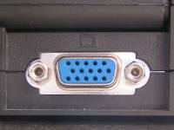
VGA Monitor
VGA is an analog interface between a PC and monitor
A VGA monitor is essentially any monitor that can accommodate the output of analogue Video Graphics Array signals – these display units also possess a VGA connector. A VGA connector is located on an extensive range of video and graphics cards in addition to both new and old computer monitors
A full sized DE-15 VGA connector typically consists of 15 pins separated in three rows
VGA monitors are fed numerous analogue component signals through connectors and cables: this includes red, green, and blue colour data, as well as horizontal and vertical sync (RGBHV) video signals.

Slide 8
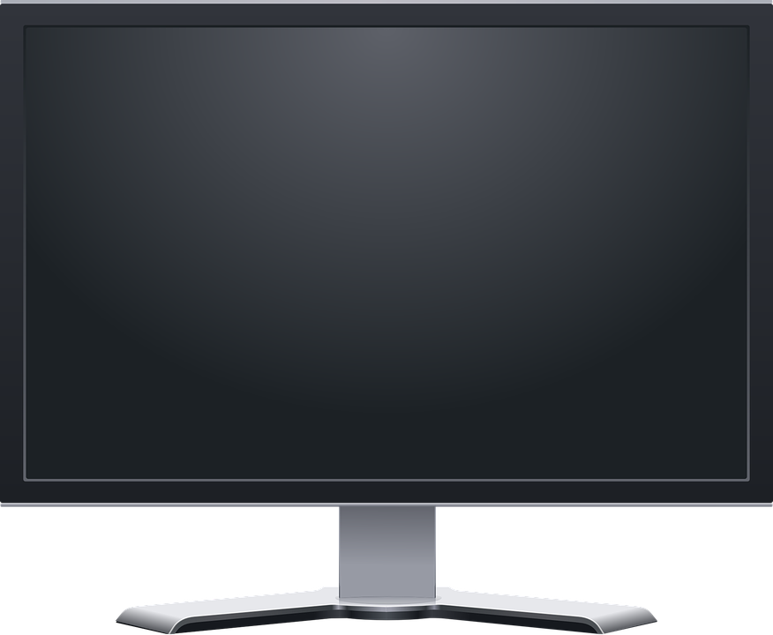
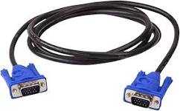
VGA Monitor

Slide 9
Modules
Our Ping Pong Game project mainly consists of the below modules……
VGA controller module
Pixel- Generation module
Debounce module
Ball_Rom module
Top module

Slide 10
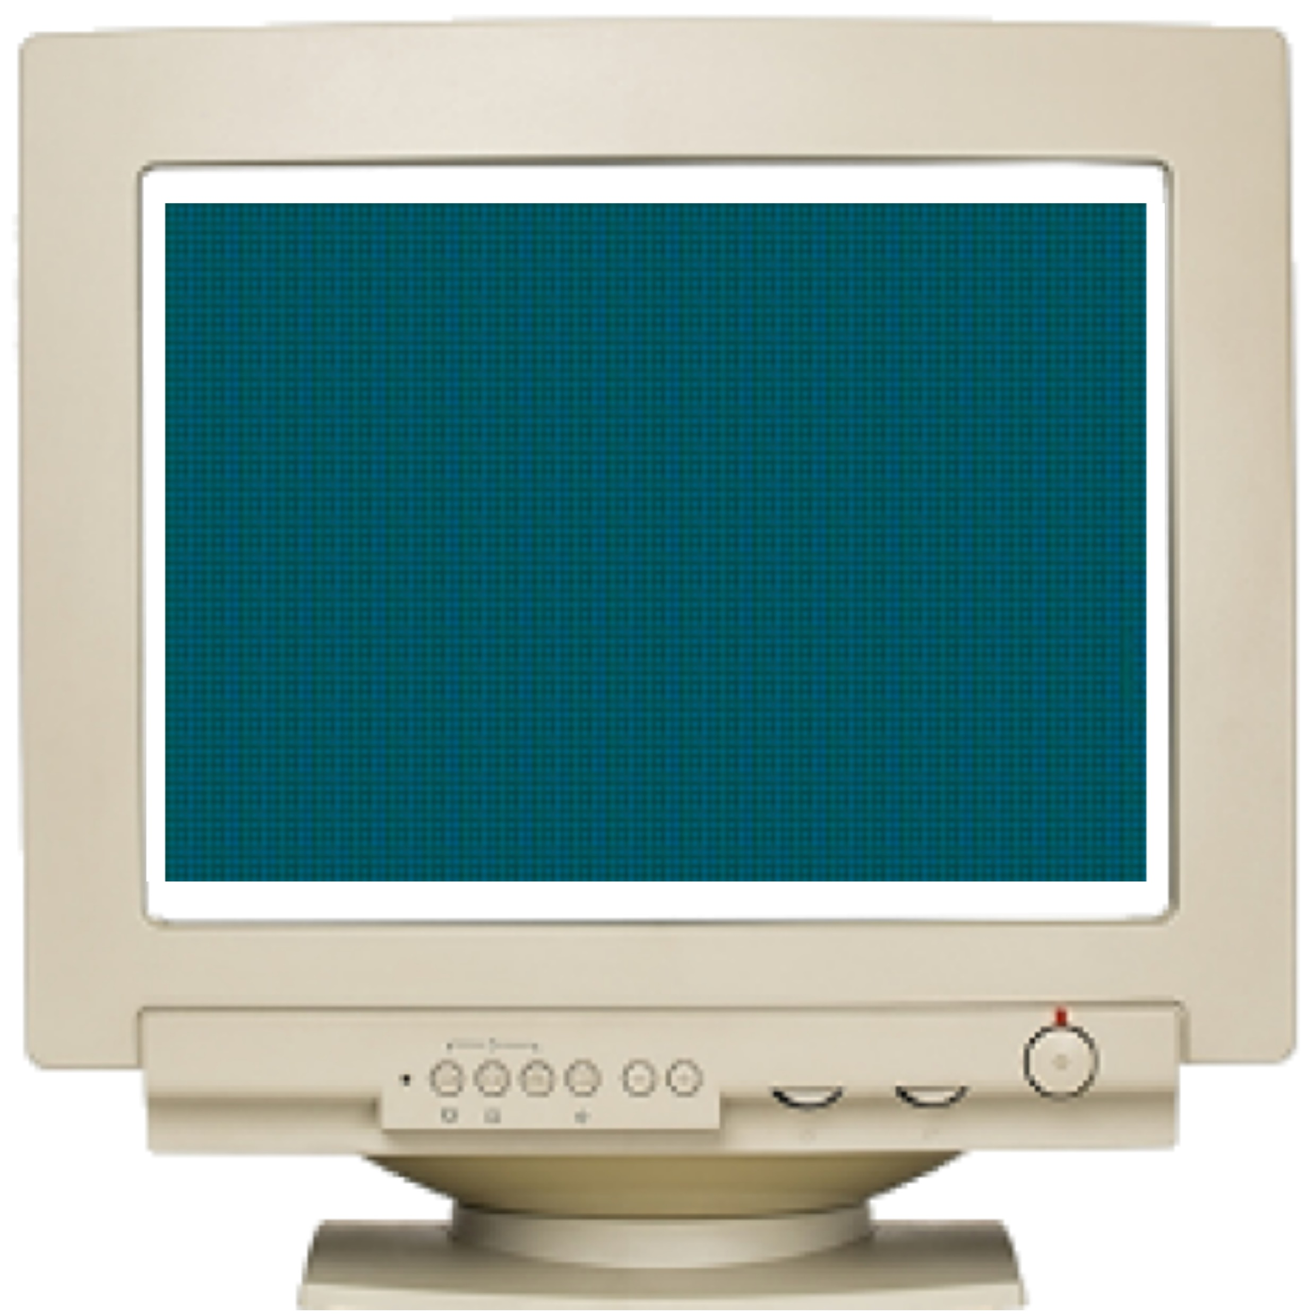
VGA Controller Module
The following discussions are based on a 640-by-480 VGA screen.
The refresh rate for the display is fixed at 60 Hz, which is the typical value used in monitors. In order to achieve this refresh rate on a 640×480 pixel screen, the pixel rate calculation is done as follows:
Pixel Rate = (Total Horizontal Pixels * Total Vertical Lines *Number of screens / second)
= 800 * 525 * 60 = 25 MHz

Slide 11
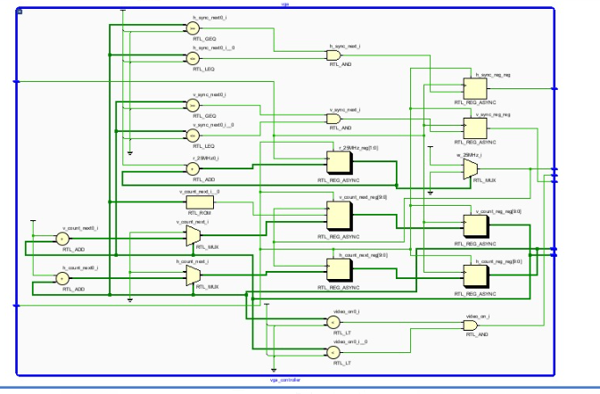
VGA Controller RTL

Slide 12
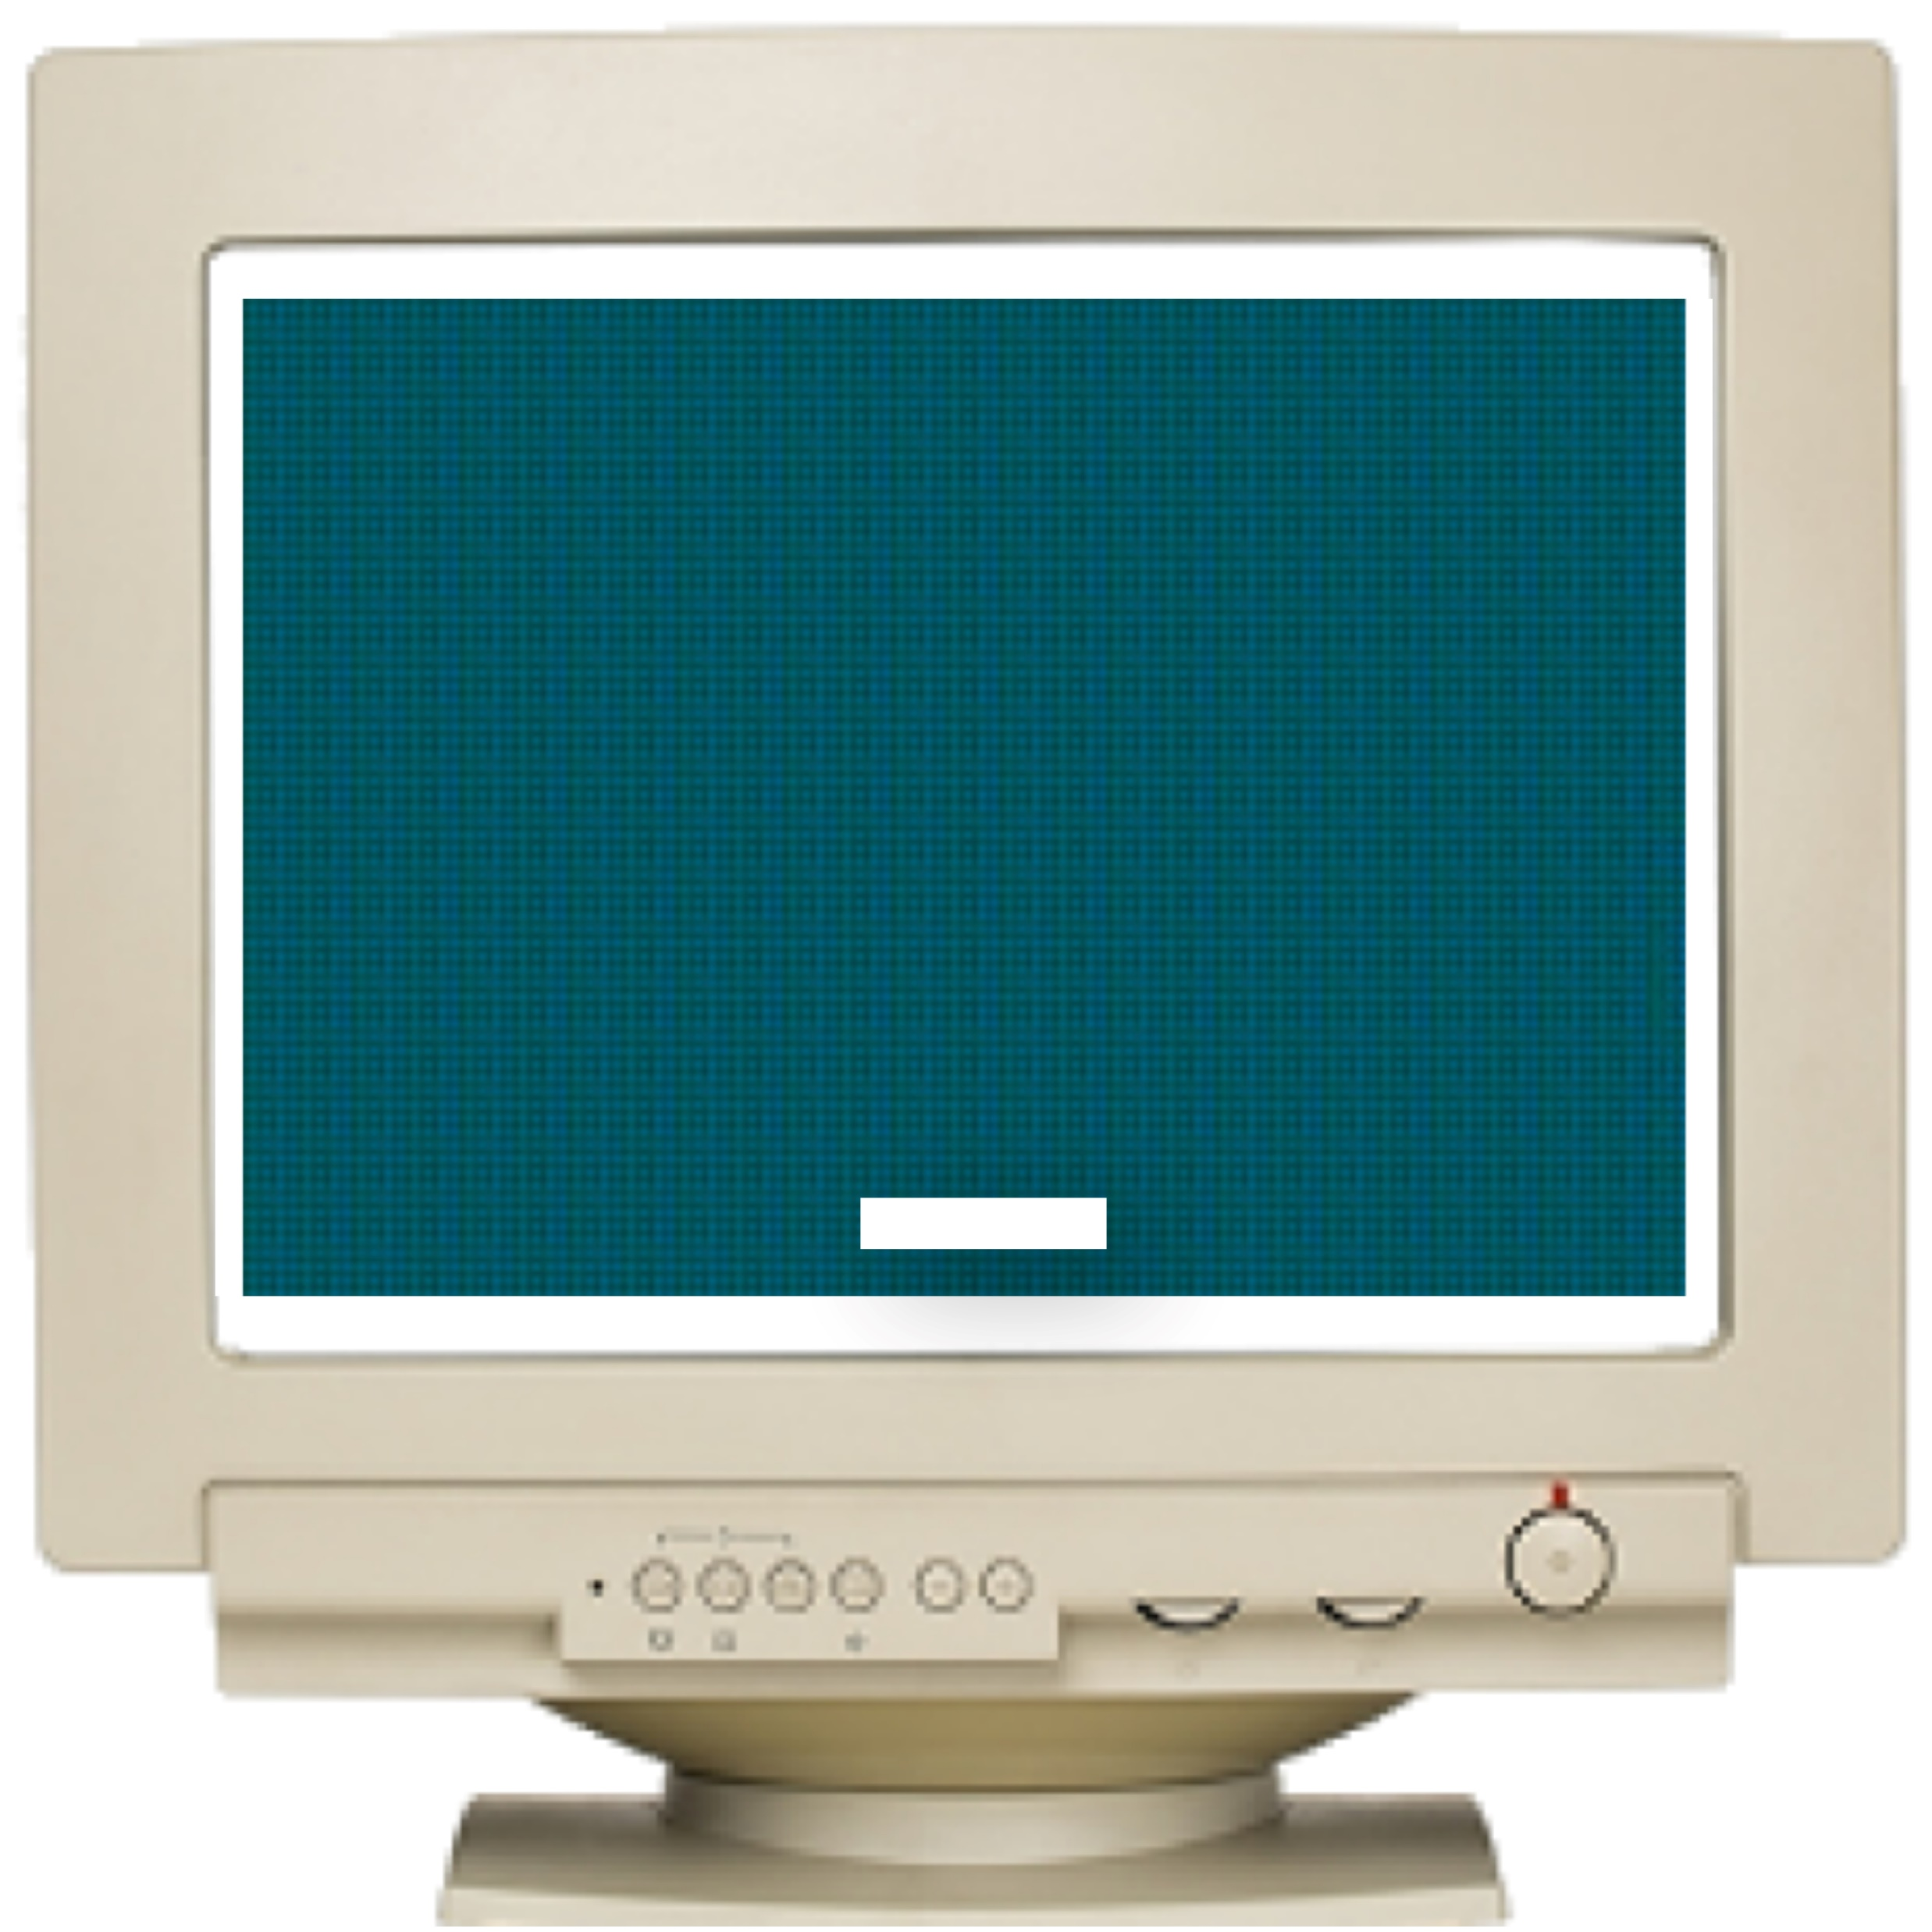
Pixel Generation Module
Every monitor has some pixel range. To turn on the monitor we need to generate pixels of both horizontal as well as vertical .In our lab we have dell monitor which has pixel range from 800*525.
Horizontal count is from 0 to 799.
Vertical count is from 0 to 524 .

Slide 13
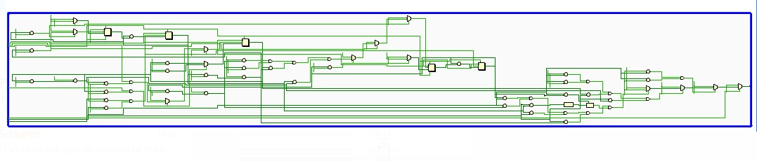
Pixel Generation module RTL

Slide 14
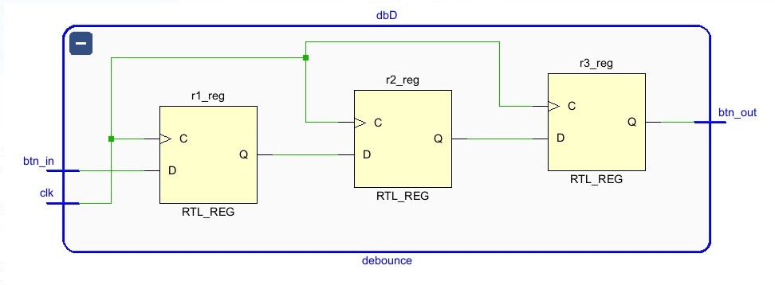
Debounce Module
Debounce module consist the logic to bounce the ball

Slide 15
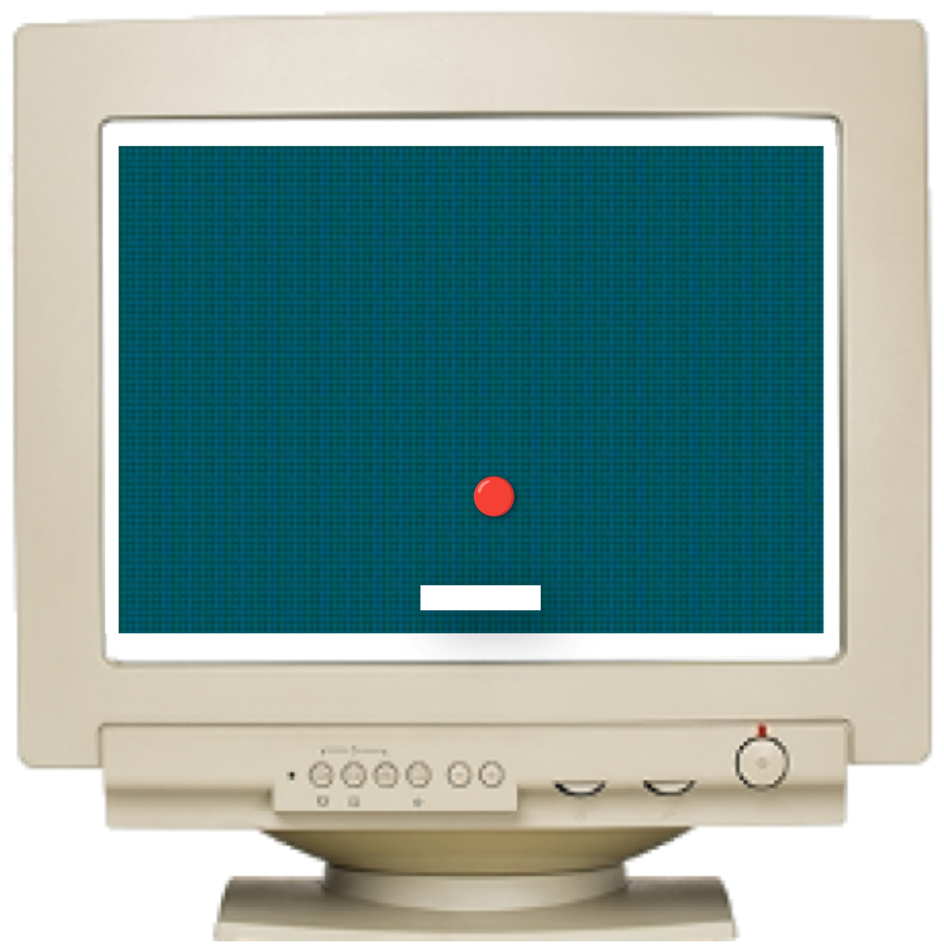
Debounce Module
Debounce module consist the logic to bounce the ball

Slide 16
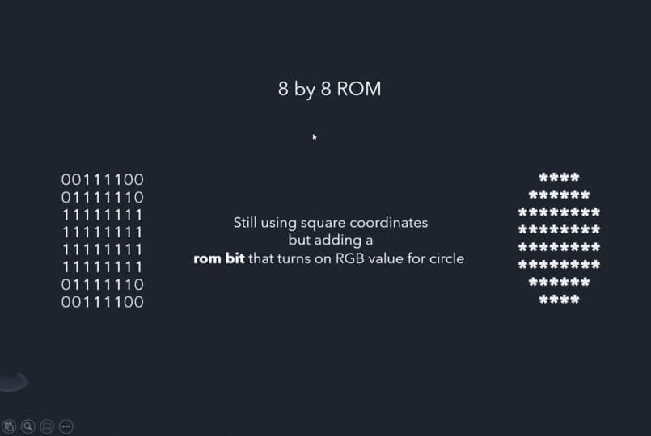
Ball_Rom Module
Normally it is easy to print a box on a monitor as it has a specific vertex at each side so we can easily identify the range of horizontal as well as the vertical pixel and will give the RGB values through the VGA pin .
But here we need to print a ball which is a circle shape as we know that circle has no particular vertex as like square so that to print the circle on the monitor we implement a Rom(Read -Only-Memory) and stored the shape of the ball in binary format at each address of the Rom .
By using the counters we will print the circle shape at our desired position in the monitor

Slide 17
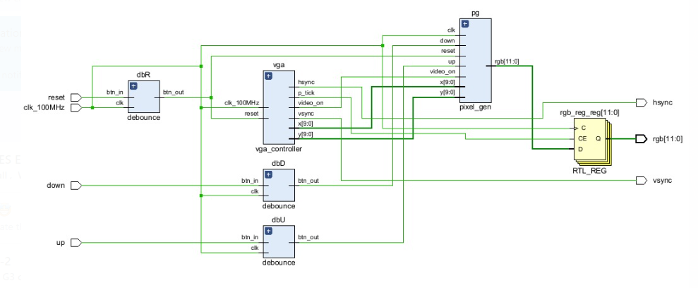
Top Module
We Instantiate all the above 3 modules that the Vga controller module, Debounce module and the pixel generation module in the top module to achieve the ping pong game.

Slide 18
Plan of Action
“Scoreboard” Module Implementation
“Game Over” Module Implementation
Code Implementation and Deployment
Project Integration on FPGA

Slide 19
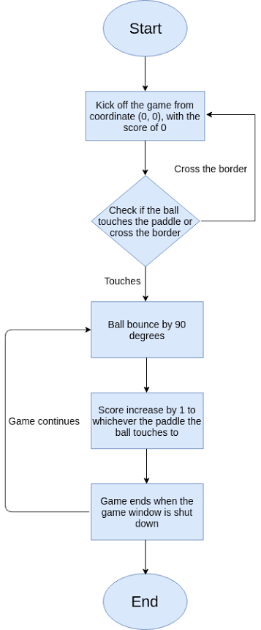
Flowchart

Slide 20
References
https://www.edaboard.com/threads/
https://pubmed.ncbi.nlm.nih.gov/23845963/
https://opencores.org/projects/vga_lcd
https://github.com/FedorChervyakov/de10lite-hello-vga

Slide 21
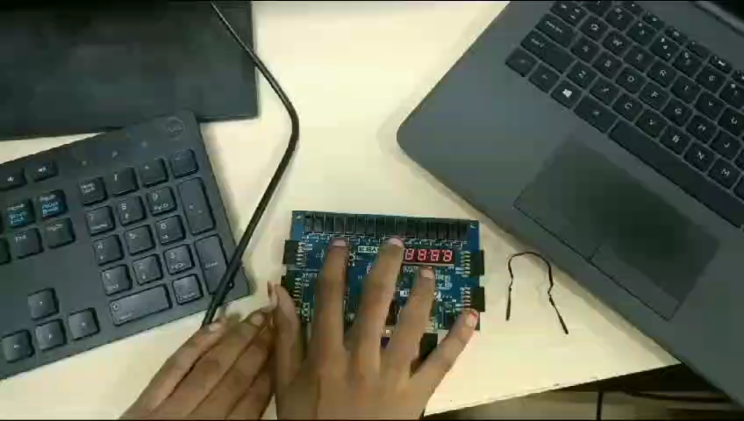
Project Integration on FPGA

Slide 22
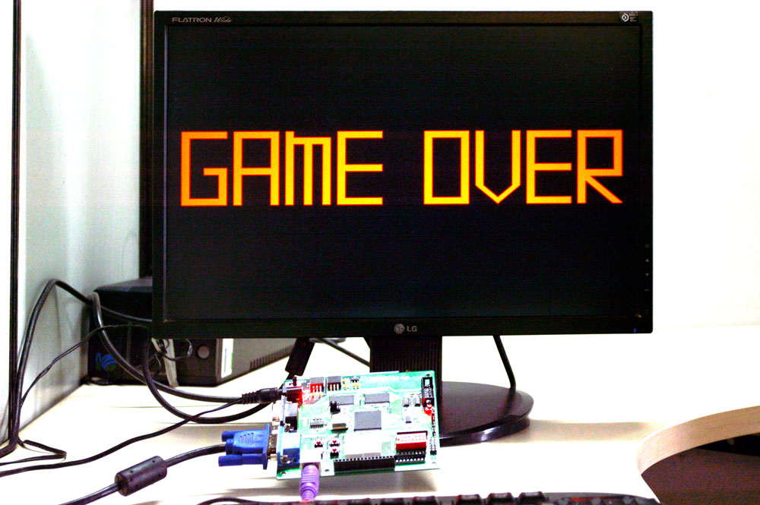
Thank You
Level up your play with the power of FPGA: Where classic Pong meets cutting-edge technology !

